Slide 1
Lecture 5:
Closed Loop Op-amp configurations

Slide 2
Outline
Closed Loop Operational Amplifier: Introduction
- Open Loop VS Closed Loop Gain
- Closed Loop Configuration: Negative Feedback
- Solving Closed Loop Circuit

Slide 3
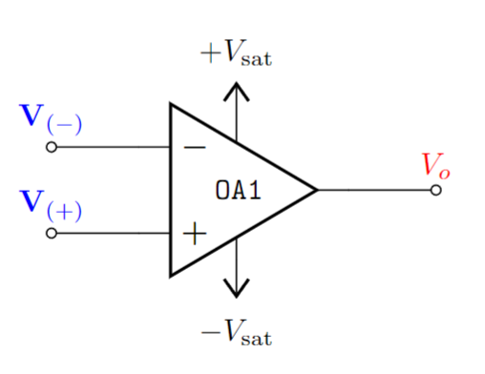
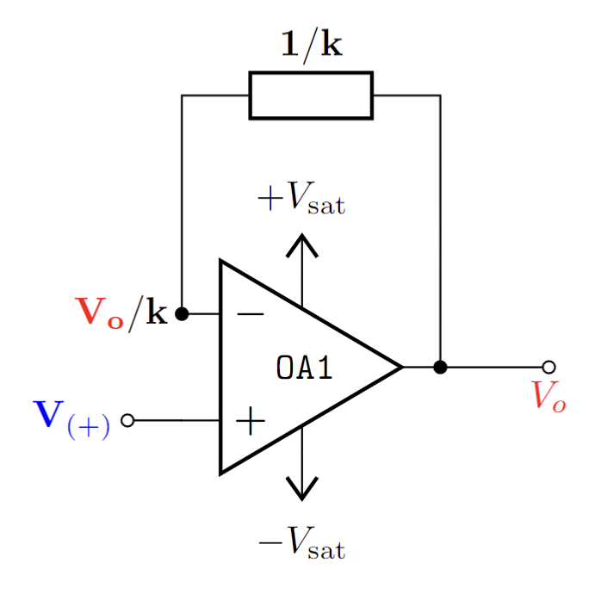
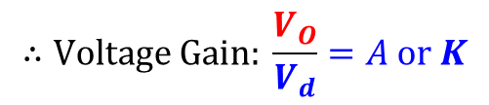
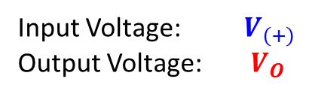
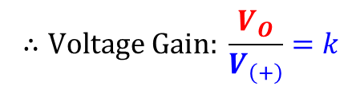
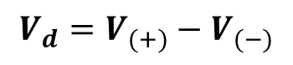
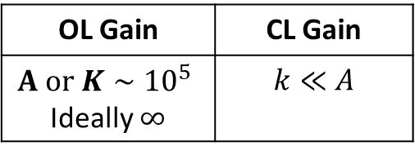

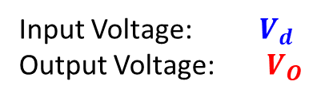
Open Loop Gain VS Closed Loop Gain
With “Negative Feedback”: Closed Loop (CL) Configuration
Open Loop (OL) Configuration
$$\{$$
$$V_{d}=V_{(+)}−V_{(−)}$$
Input Voltage: $V_{d}$
Output Voltage: $V_{O}$
Input Voltage: $V_{\left(+\right)}$
Output Voltage: $V_{O}$
OL Gain | CL Gain
$$A or K∼{10}^{5}$$ Ideally $∞$ | $$k≪A$$
$$∴Voltage Gain: \frac{V_{O}}{V_{d}}=A or K$$
$$∴Voltage Gain: \frac{V_{O}}{V_{\left(+\right)}}=k$$

Slide 4
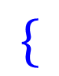
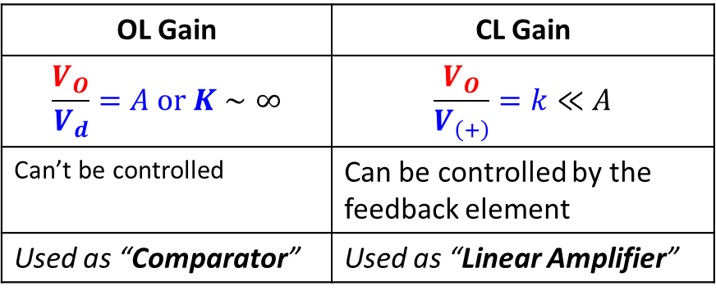
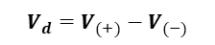
Open Loop Gain VS Closed Loop Gain
Open Loop (OL) Configuration
Closed Loop (CL) Configuration
$$\{$$
$$V_{d}=V_{(+)}−V_{(−)}$$
OL Gain | CL Gain
$$\frac{V_{O}}{V_{d}}=A or K∼∞$$ | $$\frac{V_{O}}{V_{\left(+\right)}}=k≪A$$
Can’t be controlled | Can be controlled by the feedback element
Used as “Comparator” | Used as “Linear Amplifier”

Slide 5
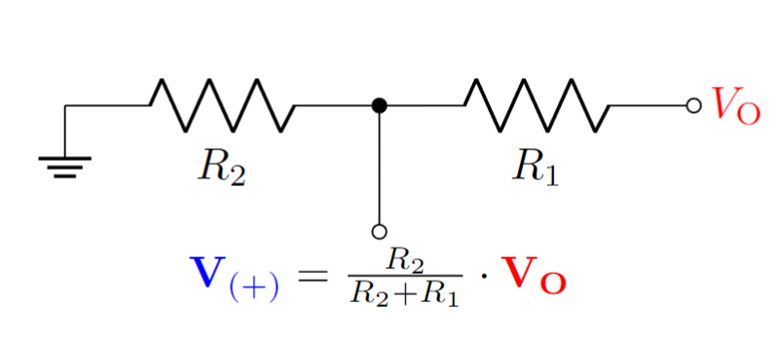

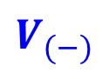

Negative Feedback in Op-Amp circuit
The output voltage is transformed in the following way:
$$V_{(−)}=\frac{1}{k}⋅V_{O}$$
This factor of $1/k$ can be achieved with a voltage divider network.
$$V_{(−)}$$
$$\frac{1}{k}=\frac{R_{2}}{R_{1}+R_{2}}$$
A voltage divider can act as a multiplier/factor in the feedback branch

Slide 6
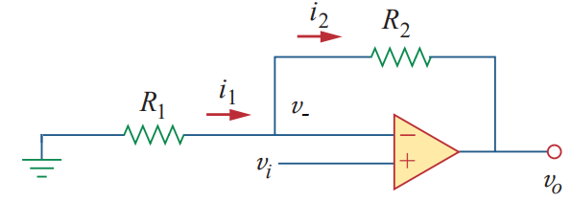
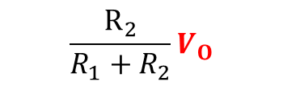
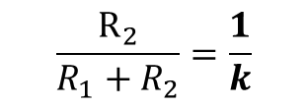

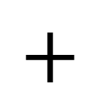
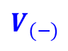
Negative Feedback in Op-Amp circuit
A voltage divider can act as a multiplier/factor in the feedback branch
$$\frac{R_{2}}{R_{1}+R_{2}}=\frac{1}{k}$$
$$\frac{R_{2}}{R_{1}+R_{2}}V_{O}$$
$$+$$
$$=$$
$$V_{(−)}$$
If $k$ = 10 (meaning we feed back one tenth of the output to negative input), we will get $v_{o}$=10*$vi$. that is 10-fold gain.

Slide 7
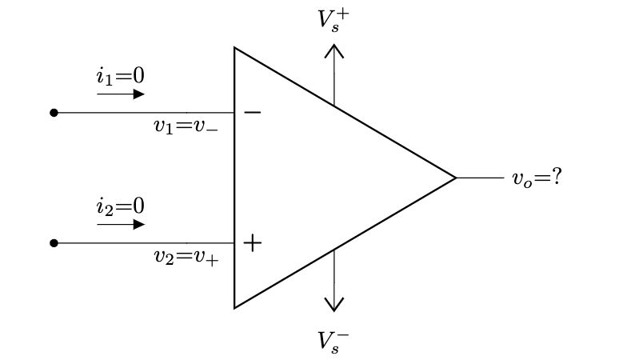
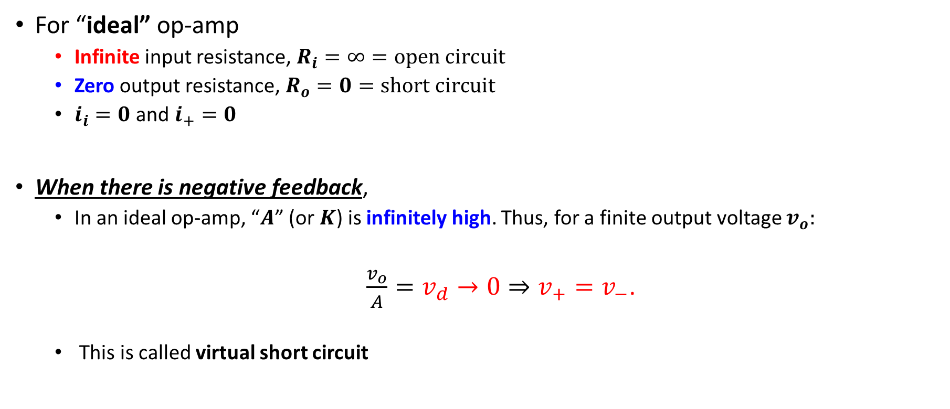
Solving Closed Loop Op-Amp Circuit
For “ideal” op-amp
Infinite input resistance, $R_{i}=∞=open circuit$
Zero output resistance, $R_{o}=0=short circuit$
$i_{i}=0$ and $i_{+}=0$
When there is negative feedback,
In an ideal op-amp, “$A$” (or $K$) is infinitely high. Thus, for a finite output voltage $v_{o}:$
$\frac{v_{o}}{A}={v_{d}→0⇒v}_{+}=v_{−}$.
This is called virtual short circuit

Slide 8
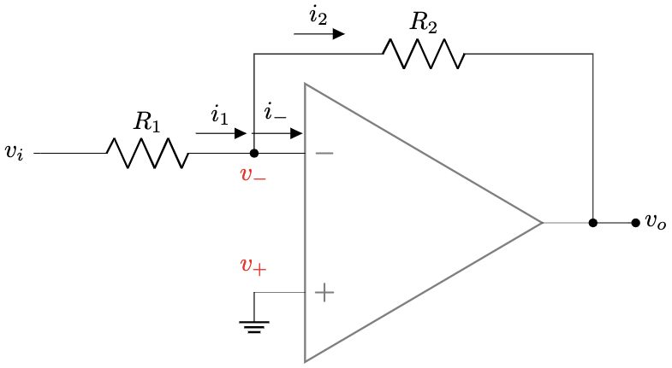
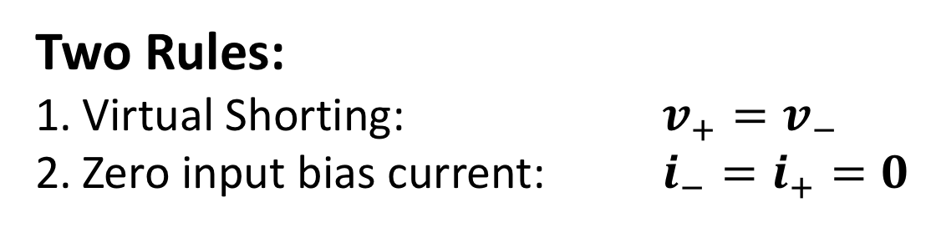
Solving Closed Loop Op-Amp Circuit
Two Rules:
Virtual Shorting: $v_{+}=v_{−}$
Zero input bias current: $i_{−}=i_{+}=0$

Slide 9
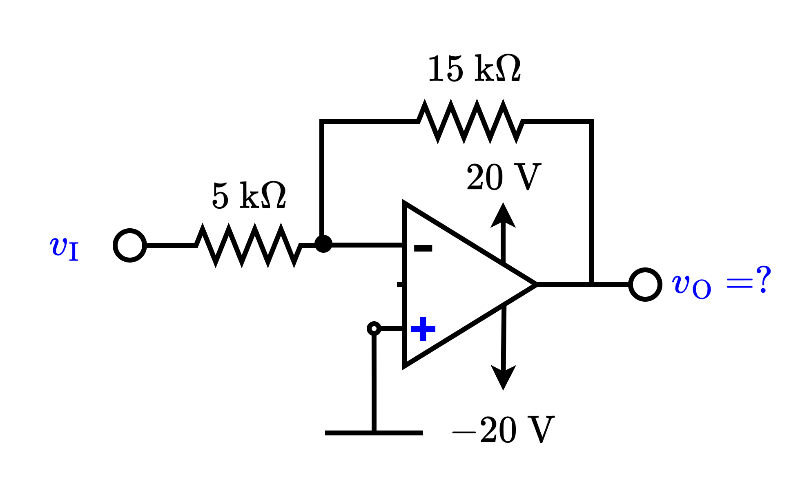
Solving Closed Loop Op-Amp Circuit

Slide 10
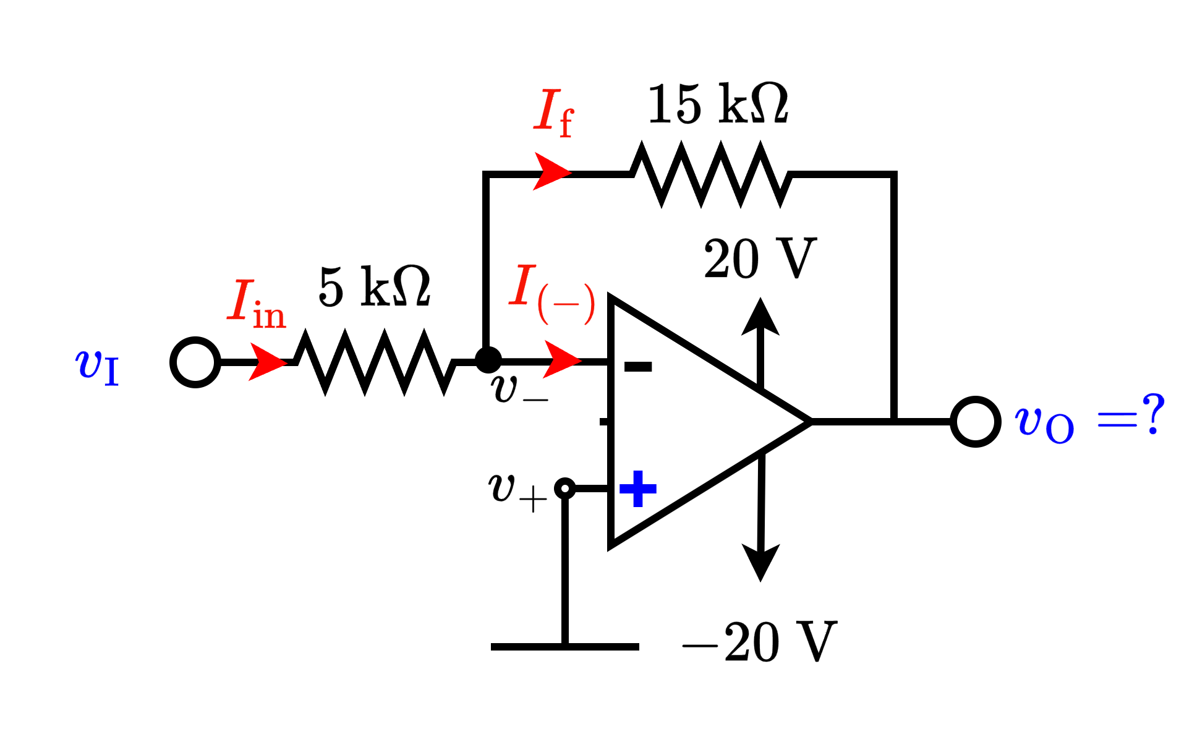
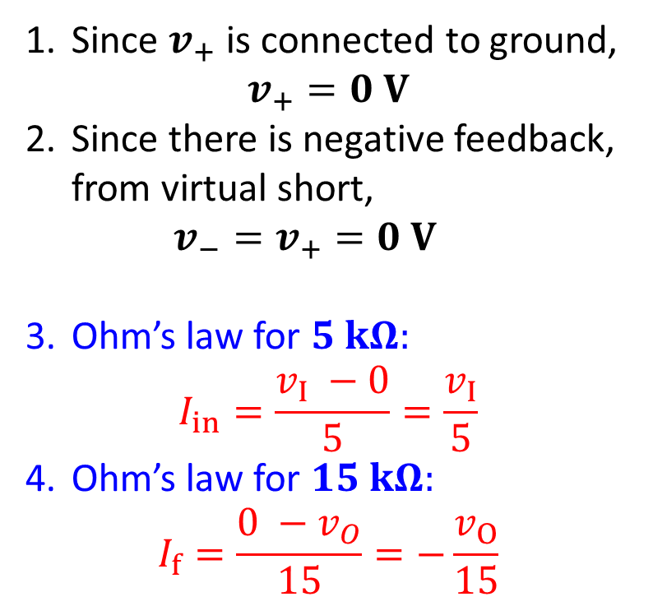
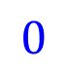
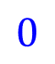
Solving Closed Loop Op-Amp Circuit
Since $v_{+}$ is connected to ground, $v_{+}=0 V$
Since there is negative feedback, from virtual short, $v_{−}=v_{+}=0 V$
Ohm’s law for $5 kΩ:$ $I_{in}=\frac{v_{I} −0}{5}=\frac{v_{I}}{5}$
Ohm’s law for $15 kΩ:$ $I_{f}=\frac{0 −v_{O}}{15}=−\frac{v_{O}}{15}$
$$0$$
$$0$$

Slide 11
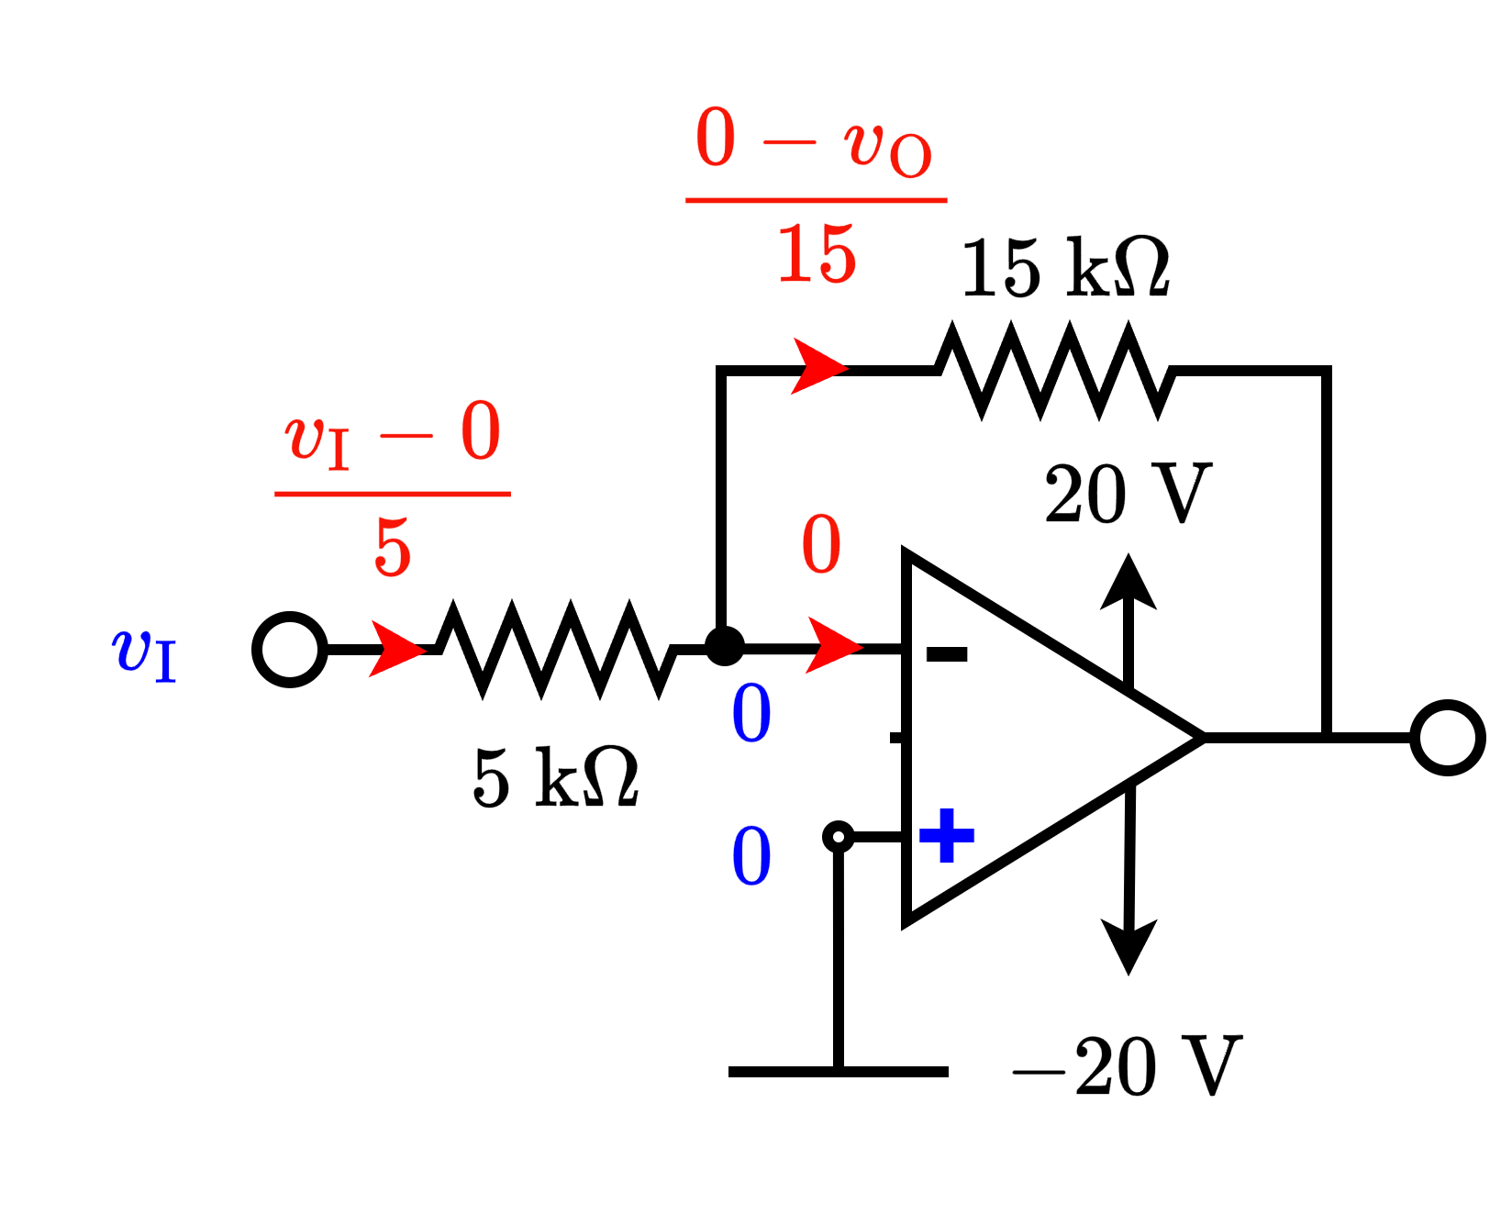
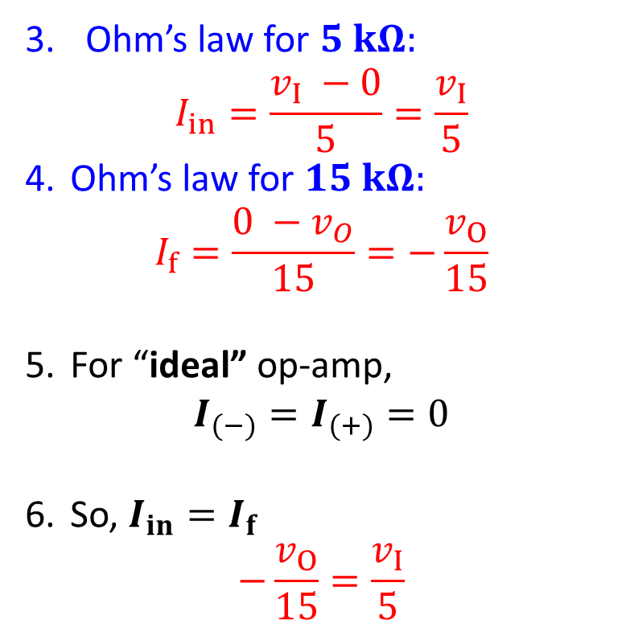
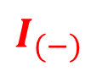
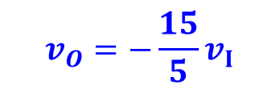
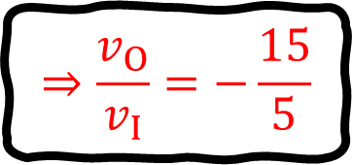
Solving Closed Loop Op-Amp Circuit
Ohm’s law for $5 kΩ:$ $I_{in}=\frac{v_{I} −0}{5}=\frac{v_{I}}{5}$
Ohm’s law for $15 kΩ:$ $I_{f}=\frac{0 −v_{O}}{15}=−\frac{v_{O}}{15}$
For “ideal” op-amp, $I_{(−)}=I_{(+)}=0$
So, $I_{in}=I_{f}$ $−\frac{v_{O}}{15}=\frac{v_{I}}{5}$
$$I_{(−)}$$
$$v_{O}=−\frac{15}{5}v_{I}$$
$$⇒\frac{v_{O}}{v_{I}}=−\frac{15}{5}$$

Slide 12
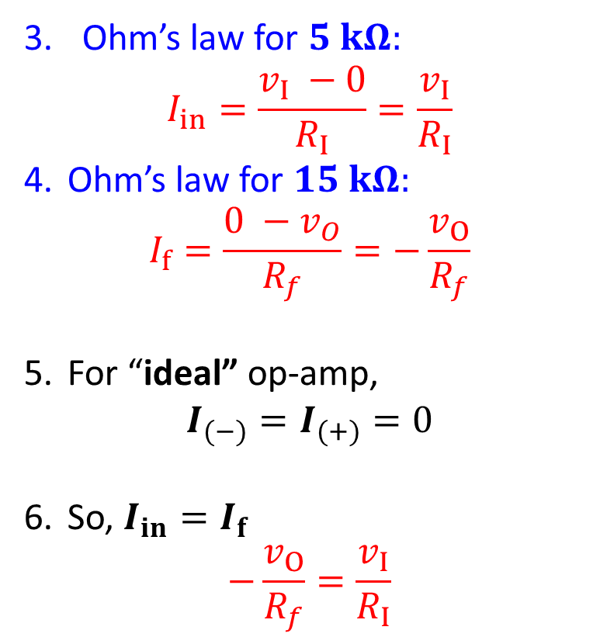
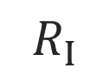
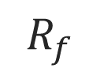
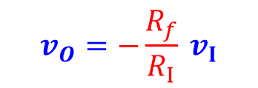
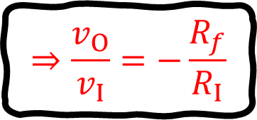
Solving Closed Loop Op-Amp Circuit
Ohm’s law for $5 kΩ:$ $I_{in}=\frac{v_{I} −0}{R_{I}}=\frac{v_{I}}{R_{I}}$
Ohm’s law for $15 kΩ:$ $I_{f}=\frac{0 −v_{O}}{R_{f}}=−\frac{v_{O}}{R_{f}}$
For “ideal” op-amp, $I_{(−)}=I_{(+)}=0$
So, $I_{in}=I_{f}$ $−\frac{v_{O}}{R_{f}}=\frac{v_{I}}{R_{I}}$
$$R_{f}$$
$$R_{I}$$
$$v_{O}=−\frac{R_{f}}{R_{I}} v_{I}$$
$$⇒\frac{v_{O}}{v_{I}}=−\frac{R_{f}}{R_{I}}$$

Slide 13
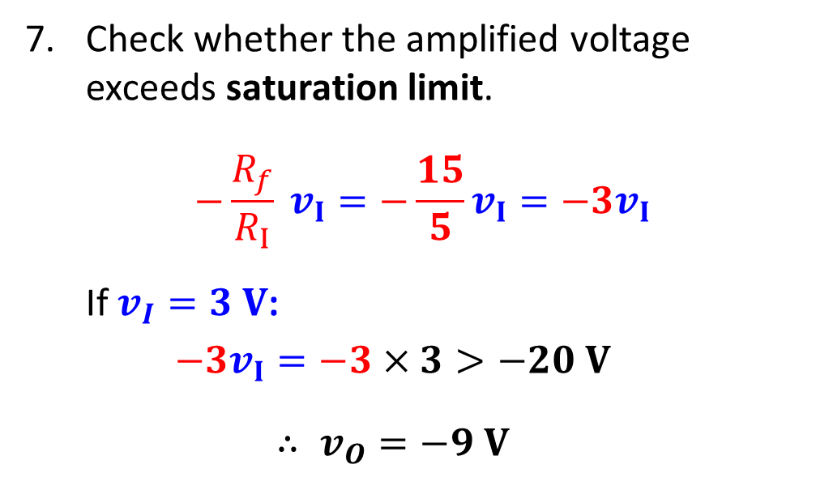
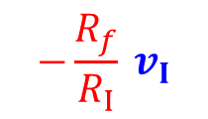
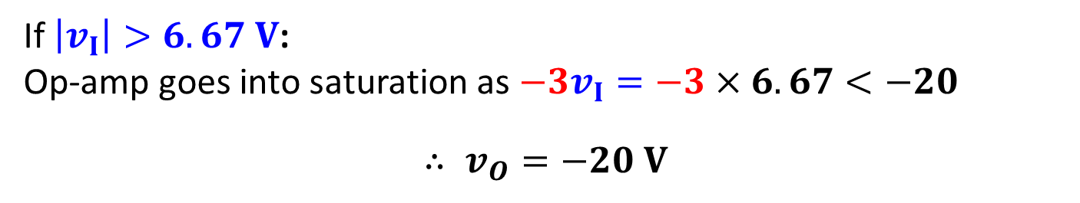
Solving Closed Loop Op-Amp Circuit
Check whether the amplified voltage exceeds saturation limit.
$$−\frac{R_{f}}{R_{I}} v_{I}=−\frac{15}{5}v_{I}=−3v_{I}$$
If $v_{I}=3 V$:
$$−3v_{I}=−3×3>−20 V$$
$$∴ v_{O}=−9 V$$
$$−\frac{R_{f}}{R_{I}} v_{I}$$
If $\left|v_{I}\right|>6.67 V$:
Op-amp goes into saturation as $−3v_{I}=−3×6.67<−20$
$$∴ v_{O}=−20 V$$

Slide 14
Part 1 ends here

Slide 15
Outline
Closed Loop Operational Amplifier: Configurations
- Basic Op-Amp Configurations: OL vs CL
- Closed Loop Configurations: Formulas and Examples

Slide 16
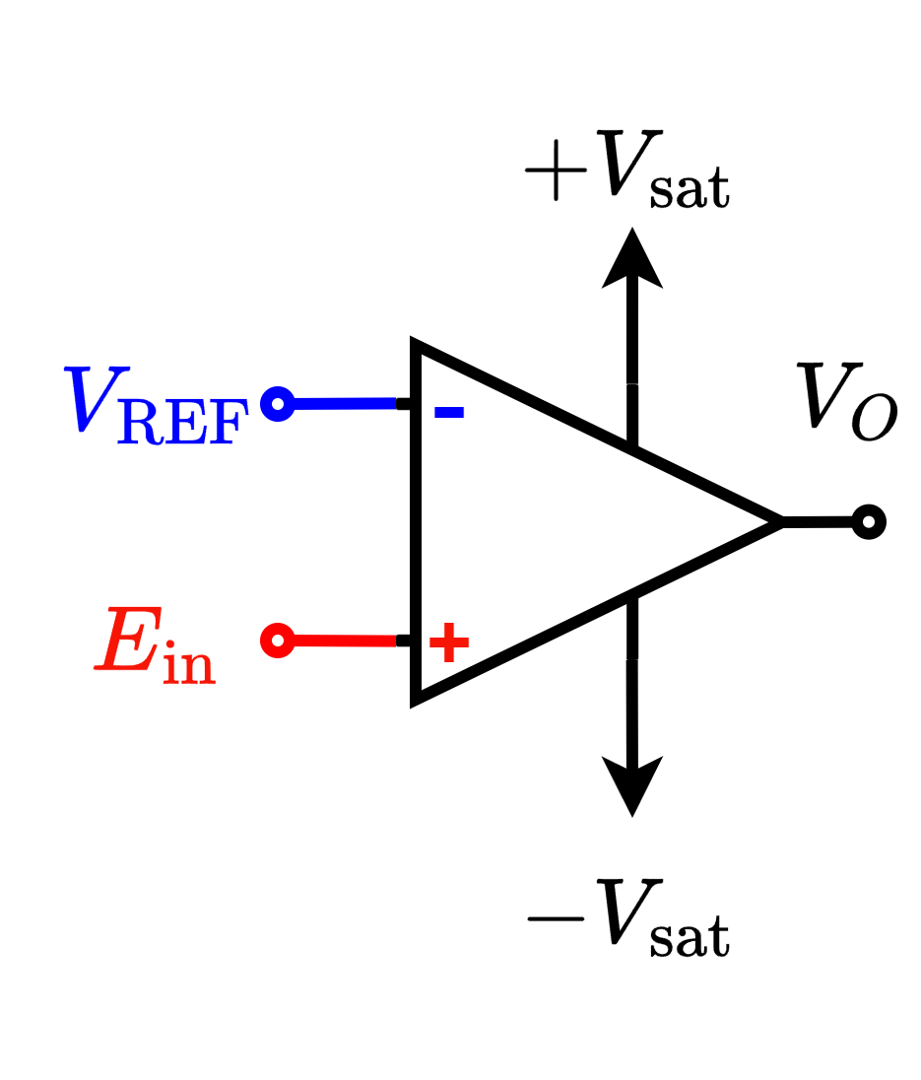
Basic Op-Amp Configurations
Open-loop Configurations
Comparator / Voltage Level Detectors
Closed Loop Configurations
Voltage Follower
Inverting Amplifier
Inverting Summer
Non-Inverting Amplifier
Weighted Subtractor
Inverting Integrator
Inverting Differentiator
Exponential Converter
Logarithmic Converter
Multiplier
Divider

Slide 17
Basic Op-Amp Configurations
Open-loop Configurations
Comparator / Voltage Level Detectors
Closed Loop Configurations
Voltage Follower
Inverting Amplifier
Inverting Summer
Non-Inverting Amplifier
Weighted Subtractor
Integrator
Differentiator
Exponential Converter
Logarithmic Converter
Multiplier
Divider

Slide 18
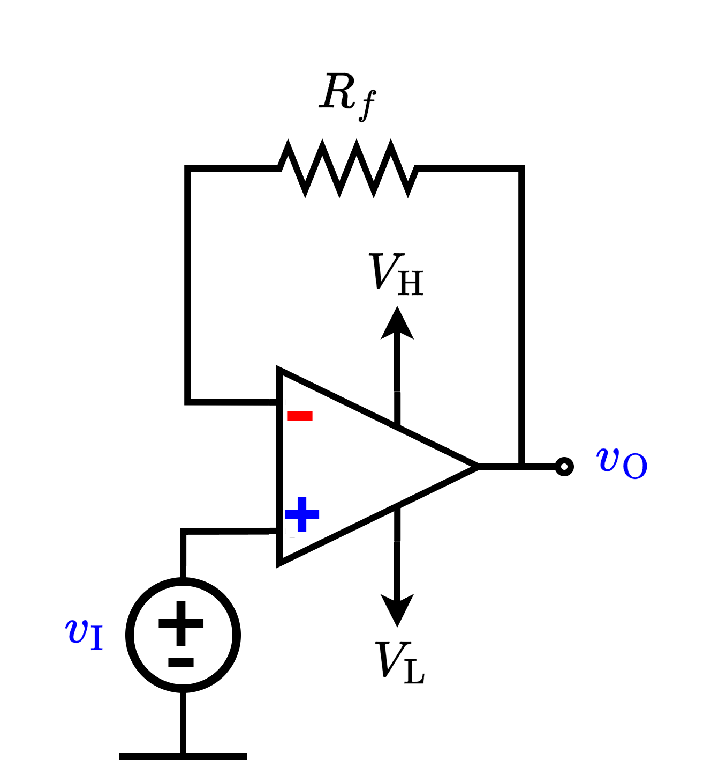
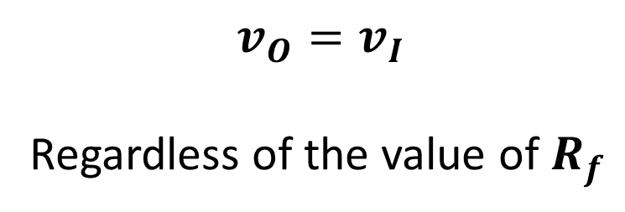
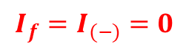
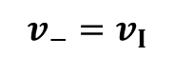
Voltage Follower / Buffer:
$$I_{f}=I_{(−)}=0$$
$$v_{O}=v_{I}$$
Regardless of the value of $R_{f}$
$$v_{−}=v_{I}$$

Slide 19
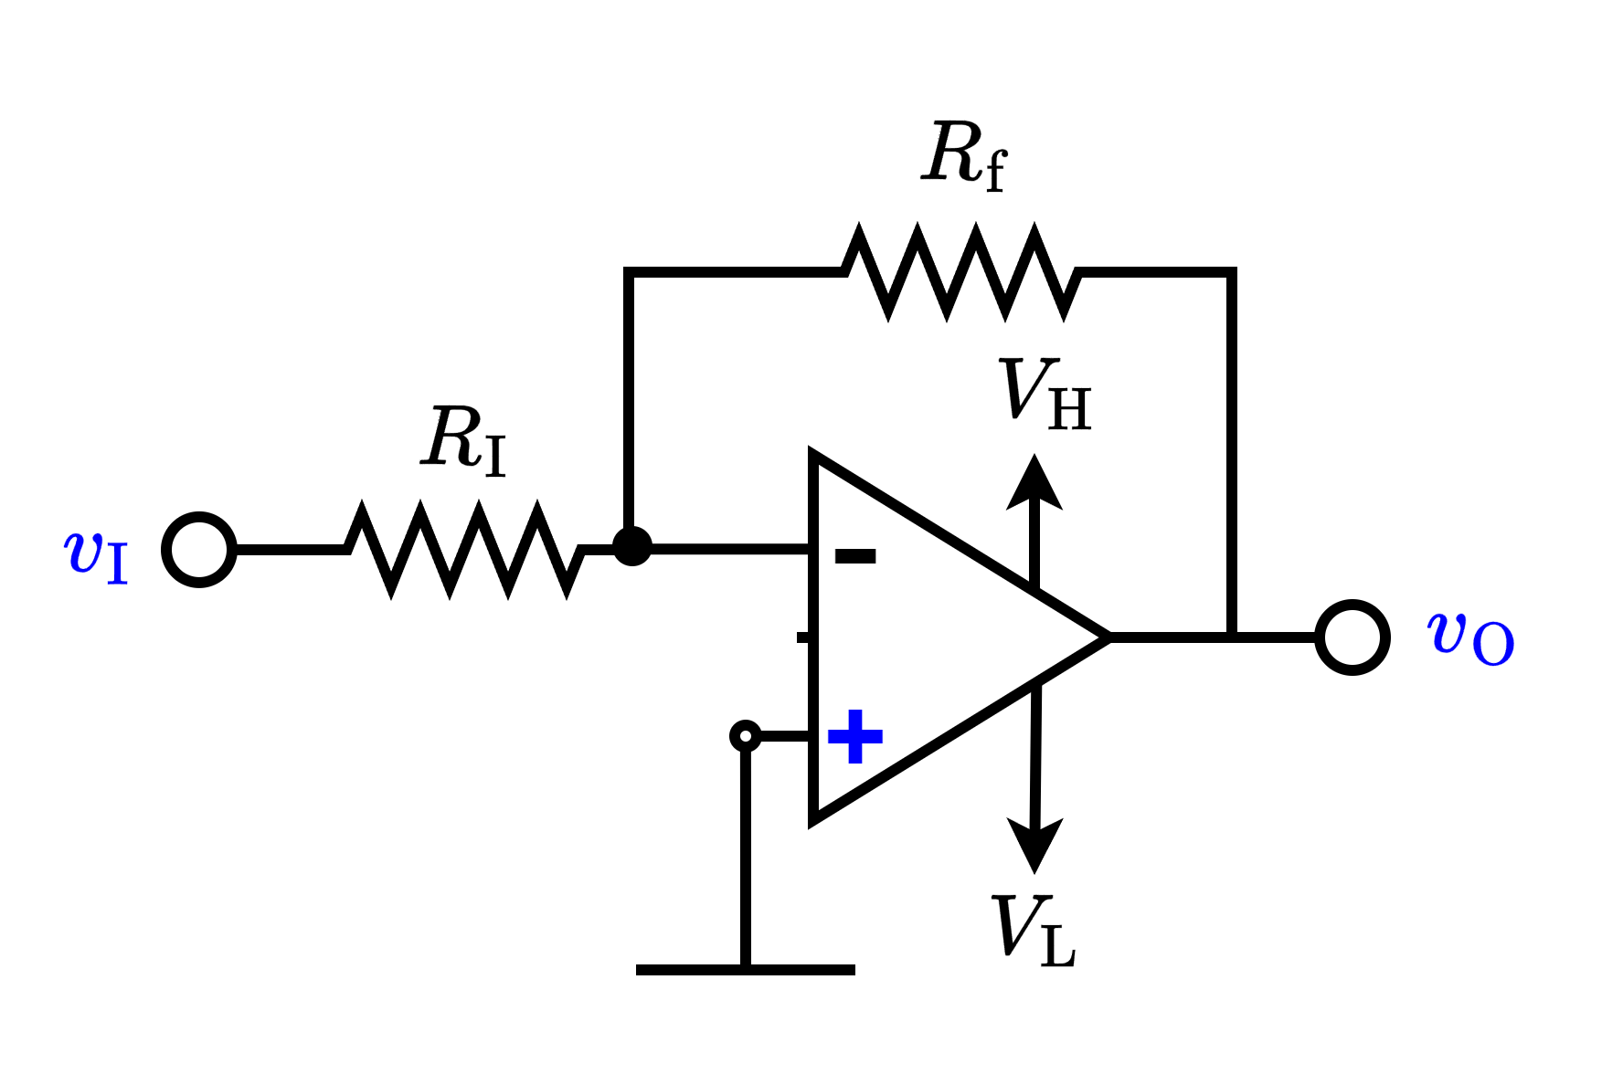
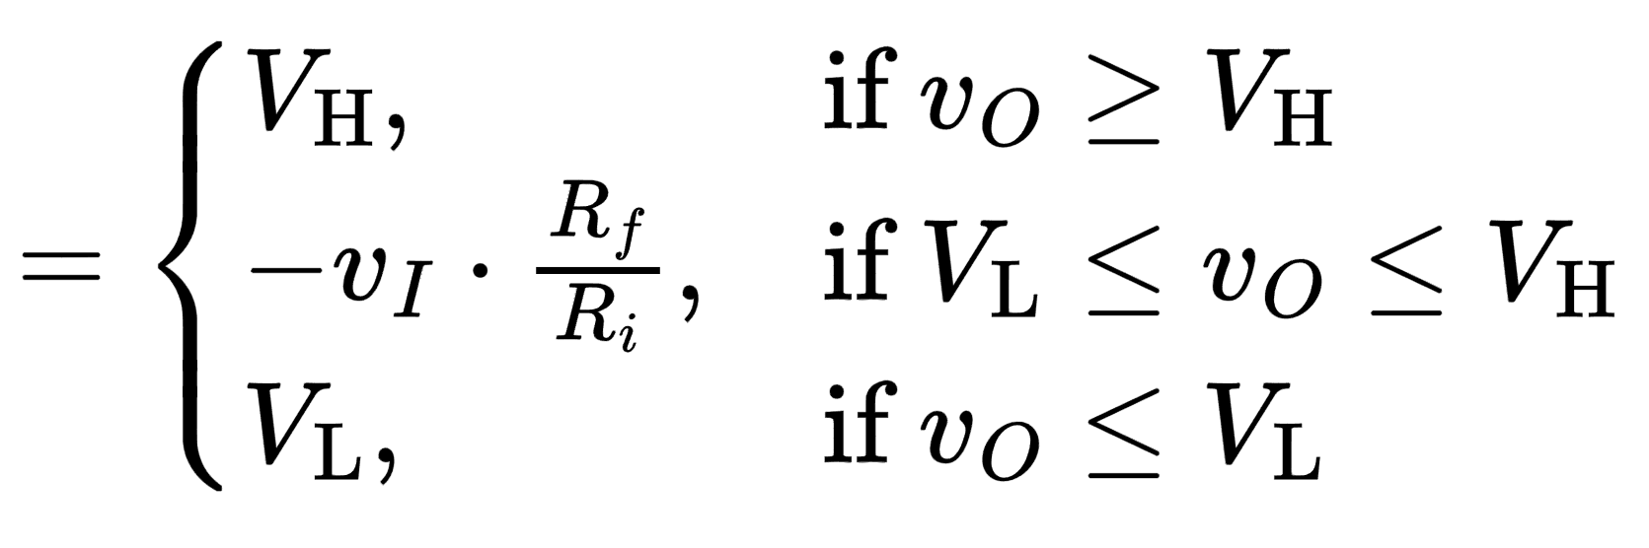
Inverting Amplifier

Slide 20
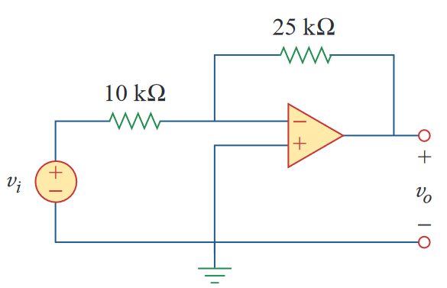
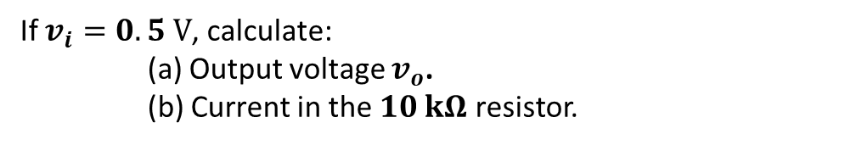
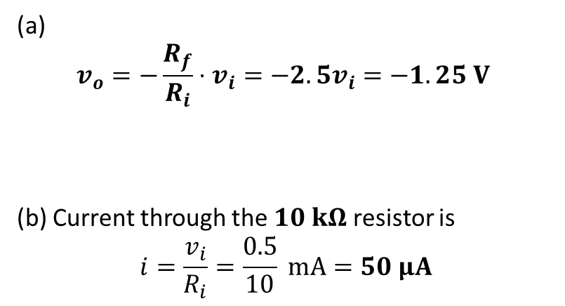
Example - 1
If $v_{i}=0.5 V$, calculate:
(a) Output voltage $v_{o}$.
(b) Current in the $10 kΩ$ resistor.
(a)
$$v_{o}=−\frac{R_{f}}{R_{i}}⋅v_{i}=−2.5v_{i}=−1.25 V$$
(b) Current through the $10 kΩ$ resistor is
$$i=\frac{v_{i}}{R_{i}}=\frac{0.5}{10} mA=50 μA$$

Slide 21




Example - 2
Design the circuit such that the closed loop voltage gain is $A_{CL} =−5$. Assume the op-amp is driven by an ideal sinusoidal source, $v_{I} = 0.1 sin (ωt) (V)$, that can supply a maximum current of $5 μA$.
$$i_{1}=\frac{v_{I}}{R_{1}}$$
$$R_{1}=\frac{v_{I}(max)}{i_{1}(max)}=\frac{0.1}{5×10^{−3}}=20 kΩ$$
$$R_{2}=−A_{CL}⋅R_{1}=5×20=100 kΩ$$
$$i_{1}$$

Slide 22




Inverting Summer
Multichannel Amplifier

Slide 23



Example - 3
Calculate:
(a) Output voltage $v_{o}$.
(b) Output current $i_{o}$.
(a)
$$v_{o}=−\left(\frac{10}{5}⋅2+\frac{10}{2.5}⋅1\right)=−8 V$$
(b)
$$i=\frac{v_{o}}{10}+\frac{v_{o}}{2}=\left(−0.8−4 \right) mA=−4.8 mA$$

Slide 24
Part 2 ends here

Slide 25






Example 4
Solution:
The given function can be achieved by an inverting summing amplifier. Having the voltage transfer formula as:
$$v_{o}=\left(−\frac{R_{f}}{R_{1}}v_{1}−\frac{R_{f}}{R_{2}}v_{2}−⋯\frac{R_{f}}{R_{n}}v_{n}\right)$$
Here, the numerators of all the coefficients of input voltages are same ($R_{f}$). As per the given problem, this can be achieved by setting the numerator to the LCM of 2 and 4 (i.e., to 8).
$$v_{o}=−\frac{2}{5}v_{1}−\frac{4}{5}v_{2}−\frac{4}{3}v_{3}$$
$$=−\frac{8}{20}v_{1}−\frac{8}{10}v_{2}−\frac{8}{6}v_{3}$$
Design an op-amp circuit with inputs $v_{1}$, $v_{2}$ and $v_{3}$ such that, output voltage $v_{o}$:
$$v_{o}=−\frac{2}{5}v_{1}−\frac{4}{5}v_{2}−\frac{4}{3}v_{3}$$
$$v_{1}$$
$$v_{2}$$
$$v_{2}$$

Slide 26








Example 4
Easier Solution:
$$v_{o}=−\frac{2}{5}v_{1}−\frac{4}{5}v_{2}−\frac{4}{3}v_{3}$$
$$=−\frac{8}{20}v_{1}−\frac{8}{10}v_{2}−\frac{8}{6}v_{3}$$
$$=−\frac{1}{5/2}v_{1}−\frac{1}{5/4}v_{2}−\frac{1}{3/4}v_{3}$$
Design an op-amp circuit with inputs $v_{1}$, $v_{2}$ and $v_{3}$ such that, output voltage $v_{o}$:
$$v_{o}=−\frac{2}{5}v_{1}−\frac{4}{5}v_{2}−\frac{4}{3}v_{3}$$
$$5/2$$
$$1$$
$$5/4$$
$$v_{1}$$
$$3/4$$
$$v_{2}$$
$$v_{2}$$

Slide 27




Example - 5
$v_{I}=0.5 V$. Calculate:
(a) Output voltage $v_{o}$.
(b) Output current $i_{o}$.
(a)
$$v_{O1}=−\frac{1}{1/5}×0.5 V=−2.5 V$$
$$v_{o}=−\frac{25}{5}⋅v_{O1}=12.5 V$$
$$v_{o}=\left(−\frac{1}{1/5}\right)⋅\left(−\frac{25}{5}\right)⋅0.5=12.5 V$$
(b)
$$i=\frac{v_{o}}{5}+\frac{v_{o}}{25}=\left(2.5+0.5 \right) mA=3 mA$$
$$v_{O1}$$

Slide 28





Example - 6
Calculate:
(a) Voltages $v_{o1}$ and $v_{O}$.
(b) Output current $i_{o}$.
$$v_{I}=0.5sin(120πt)$$
$$v_{O1}$$
$$v_{O1}=2.5sin(120πt)$$
$$v_{O}=12.5sin(120πt)$$

Slide 29



Non-Inverting Amplifier
$$v_{O}>v_{I}$$

Slide 30





Non-Inverting Amplifier: Example 7
Calculate:
(a) Output voltage $v_{o}$.
(b) Output current $I_{o}$.
(a)
$$v_{+}=\frac{4}{2+4}×3 V=2 V$$
$$v_{o}=\left(1+\frac{10}{5}\right)⋅v_{+}=6 V$$
(b)
$$i=\frac{v_{o}}{20}+\frac{v_{o}}{10}=\left(0.3+0.6 \right) mA=0.9 mA$$
$$v_{−}$$
$$v_{+}$$

Slide 31



Summary so far
Configuration | Circuit diagram | Amplification Formula
Voltage Follower |  | $$v_{O}=v_{I}$$
Inverting Amplifier |  | $$v_{O}={−\frac{R_{f}}{R_{i}}v}_{I}$$

Slide 32


Summary so far
Configuration | Circuit diagram | Amplification Formula
Inverting Amplifier |  | $$v_{O}={−\frac{R_{f}}{R_{I}}v}_{I}$$
Non-Inverting Amplifier |  | $$v_{O}={\left(1+\frac{R_{f}}{R_{I}}\right)v}_{I}$$

Slide 33



Summary so far
Configuration | Circuit diagram | Formula
Inverting Amplifier Adder |  | $$v_{O}={−(\frac{R_{f}}{R_{I}}v}_{I1}+\frac{R_{f}}{R_{I}}v_{I2})$$
Non-Inverting Amplifier Adder |  | $$v_{O}=\left(1+\frac{R_{f}}{R_{I}}\right)\left[?\right]$$

Slide 34
Part 3 ends here

Slide 35





Difference Amplifier
Simplified Circuit
$${v_{b}=v}_{a}=\frac{R_{4}}{R_{3}+R_{4}}v_{2}$$

Slide 36



Difference Amplifier
Apply superposition principle:
+
$$v_{O}^{′′}=(1+\frac{R_{2}}{R_{1}})⋅\frac{R_{4}}{R_{3}+R_{4}}v_{2}$$

Slide 37





Difference Amplifier
$$v_{O}=v_{O}^{′′}+v_{O}^{′}$$
$$v_{O}=\left(1+\frac{R_{2}}{R_{1}}\right)v_{b}−\frac{R_{2}}{R_{1}}⋅v_{1}$$
$${v_{b}=v}_{a}=\frac{R_{4}}{R_{3}+R_{4}}v_{2}$$
$$v_{O}= (1+\frac{R_{2}}{R_{1}})⋅\frac{R_{4}}{R_{3}+R_{4}}v_{2}−\frac{R_{2}}{R_{1}}⋅v_{1}$$

Slide 38



Difference Amplifier – Example 8
Design an op amp circuit with inputs $v_{1}$ and $v_{2}$ such that
$$v_{o}=−5v_{1}+3v_{2}.$$
Solution: Method 1
$$v_{O}= −\frac{R_{2}}{R_{1}}⋅v_{1}+(1+\frac{R_{2}}{R_{1}})⋅\frac{R_{4}}{R_{3}+R_{4}}v_{2}$$
$$∴\frac{R_{2}}{R_{1}}=5$$
$$∴\left(1+5\right)⋅\frac{R_{4}}{R_{3}+R_{4}}=3$$
$$⇒ R_{3}=R_{4}$$
* To implement functions of the form $v_{O}=−Av_{1}+Bv_{2}$, with difference amplifiers, $B$ must be less than $A+1$

Slide 39







Difference Amplifier – Example 9
Design an op amp circuit with inputs $v_{1}$ and $v_{2}$ such that
$$v_{o}=−3v_{1}+5v_{2}.$$
Solution: Method 2
Two stages amplifiers must be , we can implement this function.
$−3v_{1}$: Can be achieved with one stage inverting amplifier
$+5v_{2}$: Can be achieved by cascading two inverting amplifiers $→( − × − =+)$
$$5$$
$$3$$
$$3$$
* Here, in the expression of the form $v_{O}=−Av_{1}+Bv_{2}$ given in the question$B>A+1$. So, single stage difference amplifier cannot be used.

Slide 40




Subtractor ${(v}_{1}−v_{2})$
Design an op amp circuit with inputs $v_{1}$ and $v_{2}$ such that
$$v_{o}=v_{1}−v_{2}.$$
Solution: Method 1
Inverting ratio = 1
Non-inverting ratio = 1
So, $\frac{R_{2}}{R_{1}}=1$ and $\left(1+\frac{R_{2}}{R_{1}}\right)=2$.
$${∴ R}_{1}=R_{2}$$
So, to get $\left(1+\frac{R_{2}}{R_{1}}\right)⋅\frac{R_{4}}{R_{3}+R_{4}}=1$,
$$∴R_{4}=R_{3}$$

Slide 41



















Op Amp as Inverting Differentiator
Review – Capacitor
Since ideal op-amp, $i_{−}=i_{+}=0$, so $i_{1}=i_{2}$
$$i_{1}$$
$$\frac{0−V_{O} }{R}$$
$$v_{1}$$
$$v_{2}$$
$$+$$
$$−$$
$$v_{C}$$
$$C\frac{d{(V}_{i}−0) }{dt}$$
$$i_{1}=C\frac{dv_{C} }{dt}=C\frac{d{(v}_{1}−v_{2}) }{dt}$$
$$0$$
$$i_{(−)}=0$$
$$⇒−\frac{V_{o}}{R}=C\frac{dV_{i} }{dt}$$
$$⇒ V_{O}=−RC\frac{dv_{i} }{dt}$$
$$0$$

Slide 42







Op Amp as Inverting Integrator
Review – Capacitor
Since ideal op-amp, $i_{−}=i_{+}=0$, so $i_{1}=i_{2}$
$$i_{1}$$
$$C\frac{d(0−V_{O}) }{dt}$$
$$v_{1}$$
$$v_{2}$$
$$+$$
$$−$$
$$v_{C}$$
$$\frac{V_{i}−\text{0} }{R}$$
$$i_{1}=C\frac{dv_{C} }{dt}=C\frac{d{(v}_{1}−v_{2}) }{dt}$$
$$0$$
$$i_{(−)}=0$$
$$⇒\frac{V_{i}}{R}=−C\frac{dV_{O} }{dt}$$
$$⇒ V_{O}=−\frac{1}{RC}∫V_{i}(t)dt$$
$$0$$

Slide 43


Example 10
Observe the following Figure. If $V_{i}$= $\text{5}⋅\text{sin}\text{(}\text{6}\text{t}\text{)}$, Find the value of $V_{0}$
Solution:
This is a differentiator.
$${ v}_{o}=−RC\frac{dV_{i} }{dt}$$
$$=−\left(1×{10}^{6}\right)⋅\left(1×{10}^{−6}\right)×\frac{d\left(\text{5}⋅\text{sin}\text{(6}\text{t}\text{)}\right) }{dt}$$
$$=−1×\left(5×6\cos{(6t)}\right)$$
$$=−30\cos{(6t})$$

Slide 44


















Example 11
$$V_{i}$$
$$V_{M}$$
$$t$$
$$−V_{M}$$
$$\frac{T}{2}$$
$$T$$
$$\frac{3T}{2}$$
$$2T$$
$$\frac{5T}{2}$$
$$3T$$
$$V_{O}$$
$$4RC⋅\frac{V_{M}}{T}$$
$$\frac{T}{2}$$
$$\frac{3T}{2}$$
$$\frac{5T}{2}$$
Slope: $\left|\frac{dv}{dt}\right|=\frac{V_{M}−\left(−V_{M}\right)}{T/2}=\frac{4V_{M}}{T}$
$$T$$
$$2T$$
$$3T$$
$$t$$
$$−4RC⋅\frac{V_{M}}{T}$$

Slide 45







Example 12
$$V_{i}$$
$$V_{M}$$
$$t$$
$$\frac{T}{2}$$
$$T$$
$$\frac{3T}{2}$$
$$2T$$
$$\frac{5T}{2}$$
$$3T$$
$$−V_{M}$$
$$V_{O}$$
$$\frac{T}{2}$$
$$\frac{3T}{2}$$
$$\frac{5T}{2}$$
$$T$$
$$2T$$
$$3T$$
$$t$$
$$\int_{0}^{t}{v_{I}}dt=V_{M}⋅t$$
$$−\frac{V_{M}}{RC}⋅\frac{T}{2}$$

Slide 46








Example 12
$$V_{i}$$
$$V_{M}$$
$$t$$
$$\frac{T}{2}$$
$$T$$
$$\frac{3T}{2}$$
$$2T$$
$$\frac{5T}{2}$$
$$3T$$
$$−V_{M}$$
$$V_{O}$$
$$1$$
$$2$$
$$3$$
$$4$$
$$5$$
$$6$$
$t$ (ms)
$$\int_{0}^{t}{v_{I}}dt=V_{M}⋅t$$
$$−1$$

Slide 47

APPLICATIONS:
Implementing operational functions
$f=−2x−3y$
$f=−4x+5y$
$f=−7x+\frac{d}{dt}y$
$f=−\frac{1}{3}∫x⋅dt+2 ln y+4z$
$f=−3\frac{dx}{dt}+2\exp\left(y\right)+4z$
$f=xy/z$

Slide 48











APPLICATIONS:
Implementing operational functions
$f=−2x−3y$

Slide 49

















APPLICATIONS:
Implementing operational functions
$f=−4x+5y$

Slide 50












APPLICATIONS:
Implementing operational functions
$f=−7x+\frac{d}{dt}y$

Slide 51






Example
Analyze the circuit below to find an expression of $f$ in terms of inputs $x$ and $y$.
$$−\int{x dt}$$
$$\int{x dt}−\frac{dy }{dt}$$
$$−\frac{dy }{dt}$$
$$\frac{dy }{dt}$$
Solution:
$$v_{I_{1}}=−\frac{dy }{dt};v_{I_{2}}=−\frac{1}{RC}\int{x dt};v_{I_{3}}=−v_{I_{1}}=\frac{dy }{dt}; {v_{o}=−(v}_{I_{2}}+v_{I_{3}})$$

Slide 52






Example
Analyze the circuit below to find an expression of $f$ in terms of inputs $x$ and $y$.
If $x=8\cos\left(30t\right) V$ and $y=3\sin\left(30t\right) V$ and $z=1 V$
$$−\int{x dt}$$
$$=\int{x dt}−\frac{dy }{dt}−9z$$
$$−\frac{dy }{dt}$$
$$\frac{dy }{dt}$$
$f=240\sin\left(30t\right)−90 cos \left(30t\right)−9 V$
$$9z$$

Slide 53
Thank You!

